Slide 1
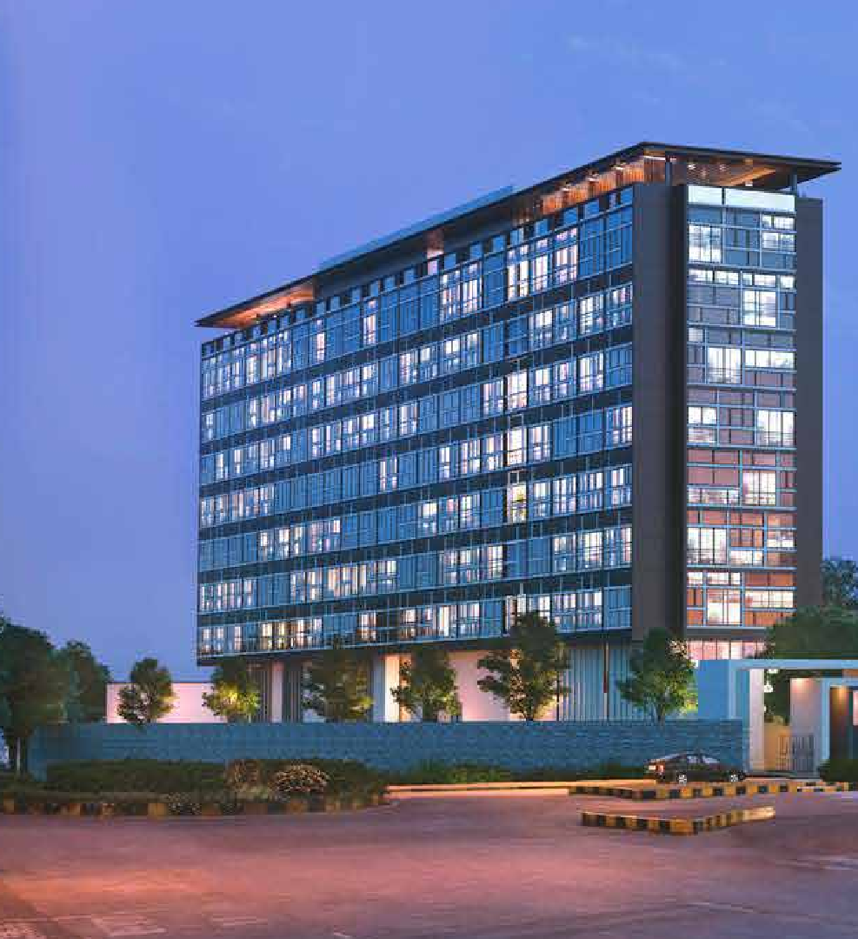















PRESENTATION
BUSINESS
24K Kraft Brewzz, V-18, Balewadi High Street, Baner, Pune

Slide 2



THE GENESIS
Hotel 24K is brainchild of Mr. Rajesh Karandikar, who holds a Master of Business Administration with specialization in Marketing.
After completing MBA, Mr. Karandikar assumed several high profile corporate positions, only to realize that his dreams are much bigger and an inner calling to implement his entrepreneurship skills propelled him to establish Hotel 24K, at the premium location of Tarabai Park in Kolhapur.
Driven by passion and a deep understanding of consumer behavior, Rajesh’s vision of Hotel 24k became a successful reality in no time. It was his innate love for gastronomy, inherent knowledge of local cuisine, with desire to provide impeccable hospitality service, that made 24K a thriving establishment.
And in collaboration with experts of the trade, he created an assortment of cocktails, mocktails and premium beverages, that were instant hit with the customers too.

Slide 3
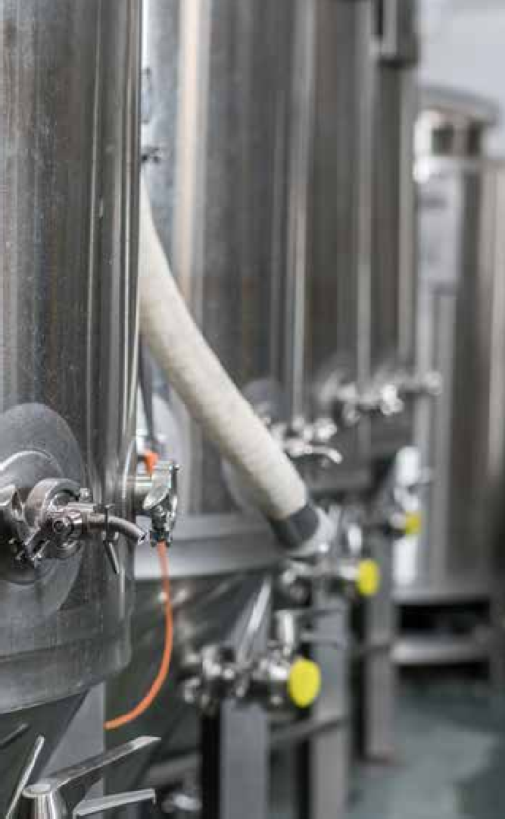

THE EPIPHANY MOMENT
In April 2016, one of Rajesh’s close friends arrived from the US with a selection of premium brands of craft beers, as a gift. What started as a casual reunion of friends, ended up in an epiphany moment for Mr. Rajesh, as he was incredibly astonished by the rich kaleidoscope of aromas & flavors of craft beers.
That amazing experience drove him to do extensive research into craft brewing and to learn the framework of excise policies & procedures. This was a great learning that eventually resulted in him launching the next chapter of the Hotel 24K vision,
i.e. a state-of-the-art microbrewery in the city of Pune, with a lavish brewpub experience in the elite location of Balewadi High Street.

Slide 4


THE STATUS QUO
As the business at Hotel 24K Kolhapur has been flourishing, a part of it has been converted into a well designed beer taproom with a unique theme & architecture.
At Hotel 24K Pune, the microbrewery is approved & is commissioned now. The bar and kitchen are going through finishing touches, planned to operate at full capacity before Diwali 2020. The brewery department is also in the safe hands of a passionate brewmaster & his team, who have graduated from prestigious VSI Pune, which is centre for Research by the Department of Science and Technology of the Central Government.
To connect our traditional business model with digital ecommerce platform, we have also launched a feature-packed mobile app & website as well, to provide a range of on-line services to our customer, with value added features like free liquor license.
And to ensure that the product of only the highest quality are offered to our customers, a bespoke delivery packaging & logistic system has also been designed, to ensure at-home customers also feel the same experience as they will have from live brew tap at the brewery.

Slide 5



THE STRATEGY
Brewing a fusion of indigenous raw materials, is the primary essence of craft brewing. Expanding our belief in this philosophy whilst bonding with our roots in Kolhapur, the raw materials are consciously selected to be included in the first phase of brewing.
They are:
Aromatic & Flavorful Wild Honey
Fragrant Ambemohor rice
Flavourful Jaggery
Design cold refrigerated home delivery solution for craft beers in both Pune & Kolhapur.
Launch beer filling stations & food joints at strategic locations in Pune & Mumbai, to promote the brand.
Enhanced hygienic dine-in experience to include thermal scanners, contactless payments, self-protection kits, separated seating, among other parallel measures like frequent sanitization, personnel hygiene, safety gear among many others.

Slide 6


A brand isn’t just a logo. Or our Business card. It’s not just words on a page or image on screen. It’s not just a billboard or an event booth. It’s these things, but relly, so much more. Most important, a brand is about people.
“Your brand is what people say about you, when you are not in the room.”
When you interact with someone, they won’t always remember the particulars of your conversation. But you can be sure they’ll remember how you made them
FEEL. That’s a brand
- Jeff Bezos, Amazon Founder
OUR BRAND

Slide 7

THE TEAM
Along with the restaurant business, 24K team has been venturing into a diverse landscape of business horizon, the latest of which is an innovation hospitality service experience through technology integration.
Registered & trademarked under the entity Truevibez Pvt. Ltd., this concept is a pioneering opportunity to expand the traditional hospitality concepts to make it more appealing to a wide new horizon of online customers, by offering services that are in high demand & significant future potential.
This idea is spread over a wide spectrum and is primarily conceptualized by Rajesh Karandikar with his business partner Alok Sambuddha.
Alok comes from a technology background with 14 years of IT experience with premium MNCs, with proficiency in merchant acquisition & servicing business.
Rajesh & Alok are supported at the board by an elite list of industry experts holding high profile positions as:
Chartered Accountant & Company Secretary
e-Commerce & Web Application Security Architect
Managing Director of a National Banking Corporation
Retired Deputy Secretary in Govt. Of Maharashtra (Multiple portfolio)
Associate VP, Digital Banking Delivery

Slide 8




“
We aim to cater to a wide range of audience through modern service offerings by continuous innovation
& by building strong relationships and technology integration.
Rajesh Karandikar
CEO

